Slide 1
Presentation for Holmusk
Sean Tok
9/5/2024

Slide 2
Aim of study
Scenario A
This RWE study is designed to understand how different clinical features (e.g., age, gender, therapeutics etc.) could influence treatment outcomes.
By understanding which factors influence treatment outcomes negatively or positively, treatment regimens/therapeutics can be designed to target specific patient subpopulations.
Patient A
(factor 1)
Patient B
(factor 0)
Treatment A
Treatment A
Better Outcome
Worse Outcome
Scenario B
Patient A
(factor 1)
Patient B
(factor 0)
Treatment A
Treatment B
Better Outcome
Better Outcome

Slide 3
Study Design
Methods
Dataset containing ~3400 rows of patient data derived from electronic health records
Clinical Features included
History of existing conditions (diabetes, substance use disorder, blood pressure, etc.)
Symptoms of sleep troubles, anhedonia, appetite, feeling depressed, suicidal thoughts
Disease severity at admission and discharge (based on the Clinical Global Impressions-Severity [CGI-S] score)
Current treatments( e.g., SSRIs, anxiolytics, etc.)
Weight, height, Date of admission
Global Assessment of Functioning in the past 24 months
Features derived from dataset:
Age, duration of stay, CGIS score change, treatment outcome, co-occurring symptoms and treatments
Handling NAs
Rows were checked whether there was a pattern to the missingness. No clear pattern and thus rows containing NAs were removed.

Slide 4
Approach to the data
Data wrangling questions:
How do the files link to each other?
Are there anomalous data values in the data?
Are there missing values?
Are they missing at random or is there a pattern?
Outliers?
What kind of features could be of interest and need to be generated?
Is there bias in the data?
Data types?
Main study question:
What could be factor(s) that influence whether the treatment of MDD was successful?
Definition of successful=Was CGIS score lower at discharge than admission?
Binary outcome and factors can be regressed using a binomial regression.

Slide 5
Data structure
4 files containing patient demographics, patient data, billing identifiers and billing amount.
Demographics
Join using patient_id
Patient_ID | Gender | Race | Resident Status
Patient_ID | Date of admission | … | Gaf_lv
Full Dataset
Clinical Data
Renamed
Join using patient_id
Column Names
id | Date of admission | … | Gaf_lv
Patient_ID | Date of admission | … | Gaf_lv
Billing identifiers
Join using bill_id
Join using patient_id
Bill_id | Patient_id | Date of admission
Bill_id | Patient_id | Date of admission | Amount
Billing amount
Bill_id | Amount

Slide 6
Data preprocessing
Some data values were inconsistent in some columns, as well as containing NAs.
Dataset was updated to render the values more consistent.
Full Dataset
Inconsistent columns and discrepancies
Actions
Column Name | Values
Patient_id | ffd9644f8daf1d28493a7cd700bb30f4
date_of_admission | 4/6/13
date_of_discharge | 15/6/13
…
Date_of_birth | 1956-04-02
Column Name | Values
medical_history_hbp | ‘Yes’,’No’,’0,’1
Gender | ‘Male’,’Female’,’m’,’f’
Race | ‘Chinese’,’Indian’,’chinese’,’India’
medical_history_tum | ‘0’,’1’,’NA’
medical_history_sud | ‘0’,’1’,’NA’
Resident_status | ‘Singaporean’, ’PR’, ’Singapore Citizen’, ‘Foreigner’
Column Name | Action
medical_history_hbp | Replace Yes and No with 0 and 1
Gender | Replace m and f with Male and Female
Race | Replace chinese and India with Chinese and Indian
medical_history_tum | Remove rows containing NA
medical_history_sud | Remove rows containing NA
Resident_status | ‘Singaporean’, ’PR’, ‘Foreigner’

Slide 7
Feature calculation
Several features that could provide value for the analysis (e.g, Age, duration of stay etc.) were calculated from the existing data.
Age=date of birth-date of admission
Duration of stay=date of discharge-date of admission
Score difference=CGIS_dis-CGIS_adm (Lower is better)
Treatment outcome: Score_difference<0=Better, Score_difference<0>=Worse or Neutral
Dummy coded as 1 for Better and 0 for Worse or Neutral.
Number of concurrent treatments= Sum of the treatment columns
Number of concurrent symptoms= Sum of the symptom columns

Slide 8
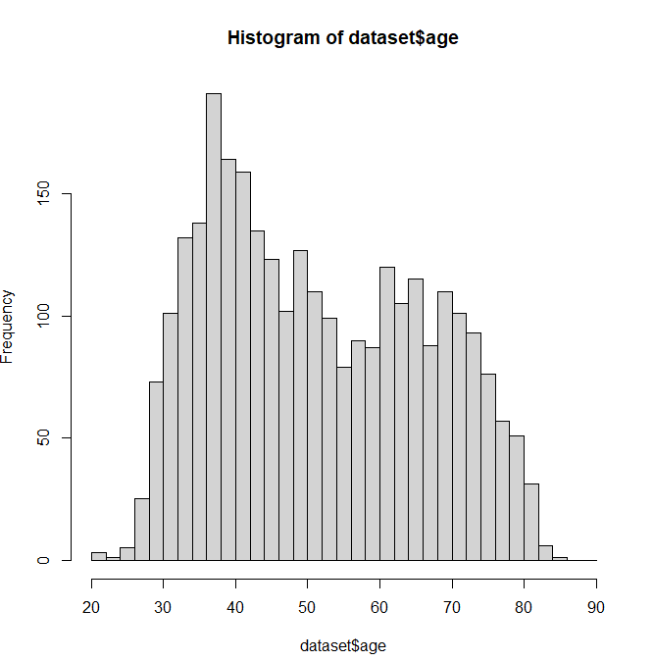
Results (Descriptive)
50.17253
Out of ~3400 rows, 2898 were retained after preprocessing
Descriptive statistics:
Race distribution: Chinese=64,Malay=21%,Indian=10% Others=5%.
Age: Mean=51.97yo, Median=50yo, Max=85, Min=21, SD=14.7165
Gender: Male=50.17%, Female= 49.82%
Resident Status: Foreigners=4.76%, PR=15.35%, Singaporean= 79.88%
Age may have a bimodal distribution
There may be a young and old subpopulation.

Slide 9
Results (Health conditions, Treatments & Symptoms)
Concurrent treatments: 90% are under 3 or more treatments
~82% are treated with antidepressants
~82% are treated with psychotherapy
~75% are treated with other therapies.
~58% are treated with anticonvulsants.
Concurrent symptoms: 84% have 3 or more symptoms
~72% show symptoms of depression
~66% show symptoms of lack of appetite
~60% show symptoms of abnormal sleep patterns

Slide 10
Results (Statistical analyses)
Binomial Regression to understand the contribution of individual factors to whether treatment was successful or not
glm(outcome~., data=stat_data,family=‘binomial’)
Where outcome is treatment outcome, coded as 1 for better, 0 for worse or neutral
Stat_data is the dataset containing features of interest to regress against.
Binomial regression since the outcome is binary.
Significant findings:
Trt_adt, Estimate=0.307508, Std. Error=0.099625, z value=3.087, p-value=0.00202
Suggests that antidepressants significantly influence outcomes

Slide 11
Key conclusions
There may be 2 age groups that are more susceptible to MDD based on age distributions
84% of patients sampled have 3 or more symptoms concurrently
90% of patients sampled receive 3 or more treatments concurrently
Treatment outcomes appear to be significantly influenced by antidepressant treatments.

Slide 12
Further analysis
Stratify patients based on age groups (bimodal appears like 2 overlapping gaussians, test for bimodality and gaussian demixing)
Diagnostic tests for normality, heteroscedasticity, etc.
Investigate multicollinearity in dataset.
Run post-hoc test and adjustments for multiple comparisons
Run analysis with NAs included, by dropping the columns instead. (should be guided by literature)
Since outcome does not quantitively measure treatment effect, another model could be applied (e.g., ordinal logistic regression)?
Model the dataset with mixed effects to account for patient heterogeneity?
Higher-order interactions

Slide 13
Assumptions and limitations
Assumptions:
Demographics are representative of population (Seems representative)
Missing data is completely at random.
NA data removed does not significantly bias remaining data.
Patients respond similarly to treatments.
Other errors in dataset such as bias, duplicates, formatting, sampling and measurement error aren’t present.
Limitations
Only 2 outcome categories, and does not quantify strength of treatment.
Other outcome variables could be taken into account
Many features with limited sample size. Could be influencing estimates
More work is needed to validate the model.

Slide 14
Questions?

